Slide 1
Editing photos apps and photography
GROUP 1 CLASS C I

Slide 2
Team us
Arranged by :
Ridho Novan Imanda (202151101)
Dwi Septiani (202151110)
Rizki Yonda Pratama (202151125)
Rasyida Hanun Dhiya Reswara (202151126)

Slide 3
PHOTOGRAPHY
ART
LIGHT

Slide 4
01
01
ADOBE PHOTOSHOP

Slide 5

ADOBE PHOTOSHOP (LAYER STYLE)
Editing
Software
Photos
Manipulate

Slide 6
TOOLS AND THE FUNCTIONS OF ADOBE PHOTOSHOP
Adjusment Layer
Brush tool
Masking

Slide 7
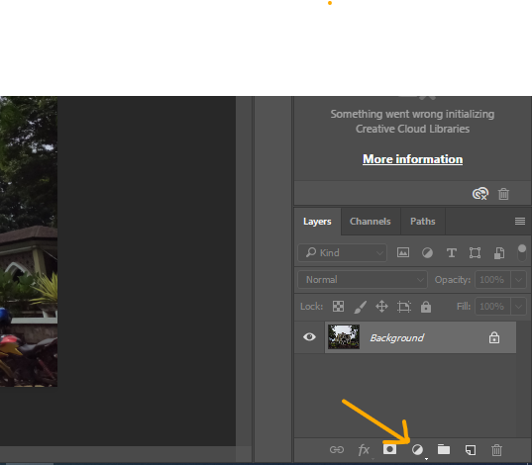
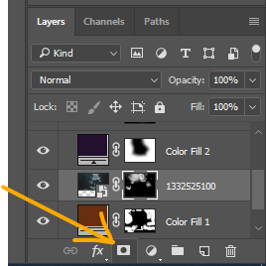
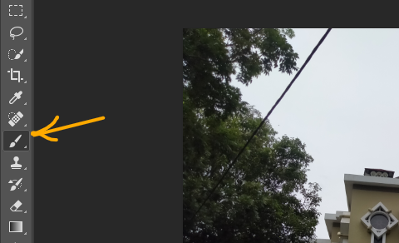
Adjustmen Layer
Add Mask
Brush Tool

Slide 8


Before
After

Slide 9
THE ADVANTAGES OF ADOBE PHOTOSHOP
Superior features
Complete editing facilities
Correcting or manipulating photos
Have more effects

Slide 10
THE DISADVANTAGES OF ADOBE PHOTOSHOP
Requires high computer specifications
So many layers are confusing
Not good to make grafis design

Slide 11
02
PICTSART
02

Slide 12

PICTSART
Android/IOS
Editing
Photos

Slide 13
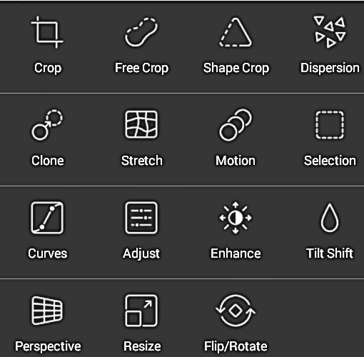
TOOLS AND THE FUNCTIONS OF PICTSART
Crop
Free crop
Shape crop
Dispersion
Clone
Motion
Selection
Curves
Adjust
Enhance
Tit shift
Prespektive
Resize
Flip/rotate

Slide 14
THE ADVANTAGES OF pICTSART
Just Need A Light Memory
Interesting features
So easy to use

Slide 15
THE DISADVANTAGES OF PICSART
Need internet connection
Not All Features Can Be Used For Free
Home page make confused

Slide 16
conclusion
Vs
PRESENTATION BY SLIDESGO

Slide 17
THANK YOU

